Slide 1
Module 2

Slide 2
Classification using Naive Bayes Algorithm

Slide 3
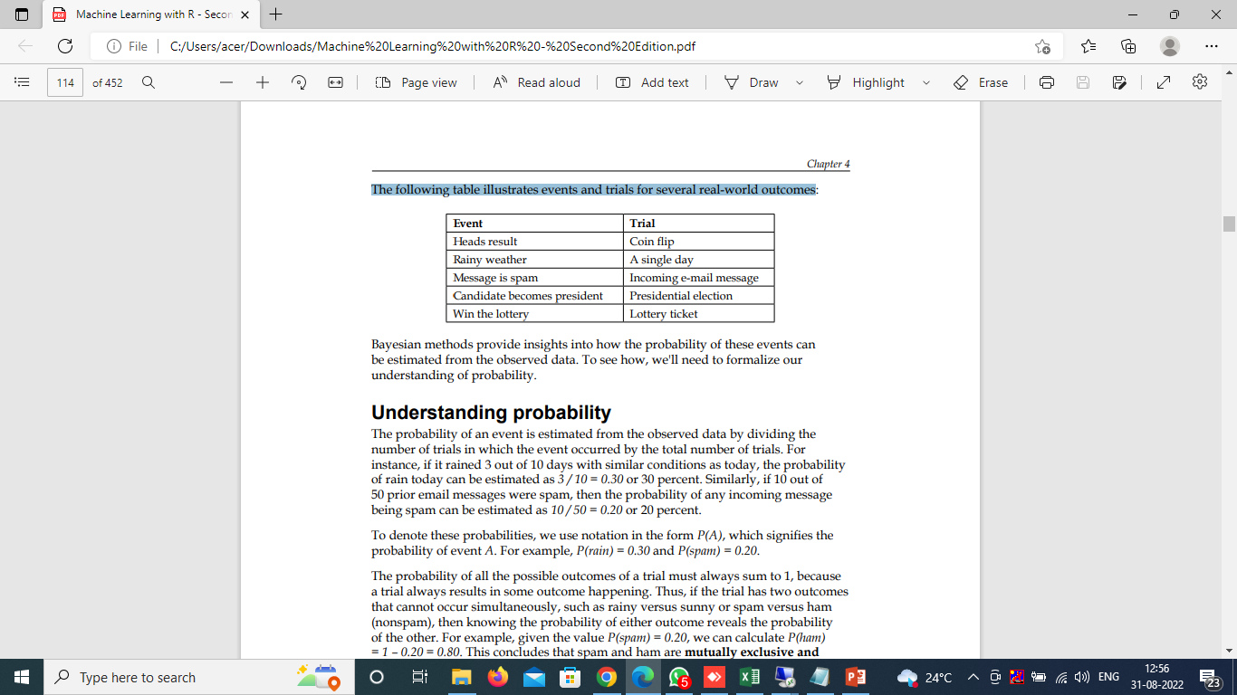
Basic concepts of Bayesian methods
Bayesian probability theory is rooted in the idea that the estimated likelihood of an event, or a potential outcome, should be based on the evidence at hand across multiple trials, or opportunities for the event to occur.
The following table illustrates events and trials for several real-world outcomes
Bayesian methods provide insights into how the probability of these events can be estimated from the observed data.

Slide 4
Understanding probability
The probability of an event is estimated from the observed data by dividing the number of trials in which the event occurred by the total number of trials.
For instance, if it rained 3 out of 10 days with similar conditions as today, the probability of rain today can be estimated as 3 / 10 = 0.30 or 30 percent.
To denote these probabilities, we use notation in the form P(A), which signifies the probability of event A. For example, P(rain) = 0.30
The probability of all the possible outcomes of a trial must always sum to 1, because a trial always results in some outcome happening. Thus, if the trial has two outcomes that cannot occur simultaneously, such as rainy versus sunny then knowing the probability of either outcome reveals the probability of the other. For example, given the value P(rain) = 0.20, we can calculate P(sunny) = 1 – 0.20 = 0.80. This concludes that rain and sunny are mutually exclusive and exhaustive events, which implies that they cannot occur at the same time and are the only possible outcomes.

Slide 5
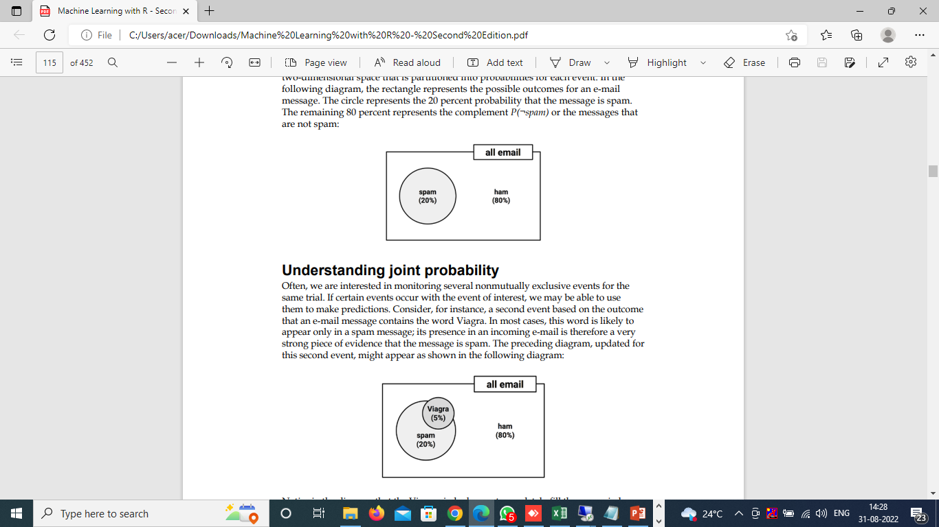
An event cannot simultaneously happen and not happen, an event is always mutually exclusive and exhaustive with its complement.
The complement of event A is typically denoted Ac or A'. A
the shorthand notation P(¬A) can used to denote the probability of event A not occurring, as in P(¬rain) = 0.80.
To illustrate events and their complements, it is often helpful to imagine a two-dimensional space that is partitioned into probabilities for each event. In the following diagram, the rectangle represents the possible outcomes for an e-mail message. The circle represents the 20 percent probability that the message is spam. The remaining 80 percent represents the complement P(¬spam) or the messages that are not spam

Slide 6
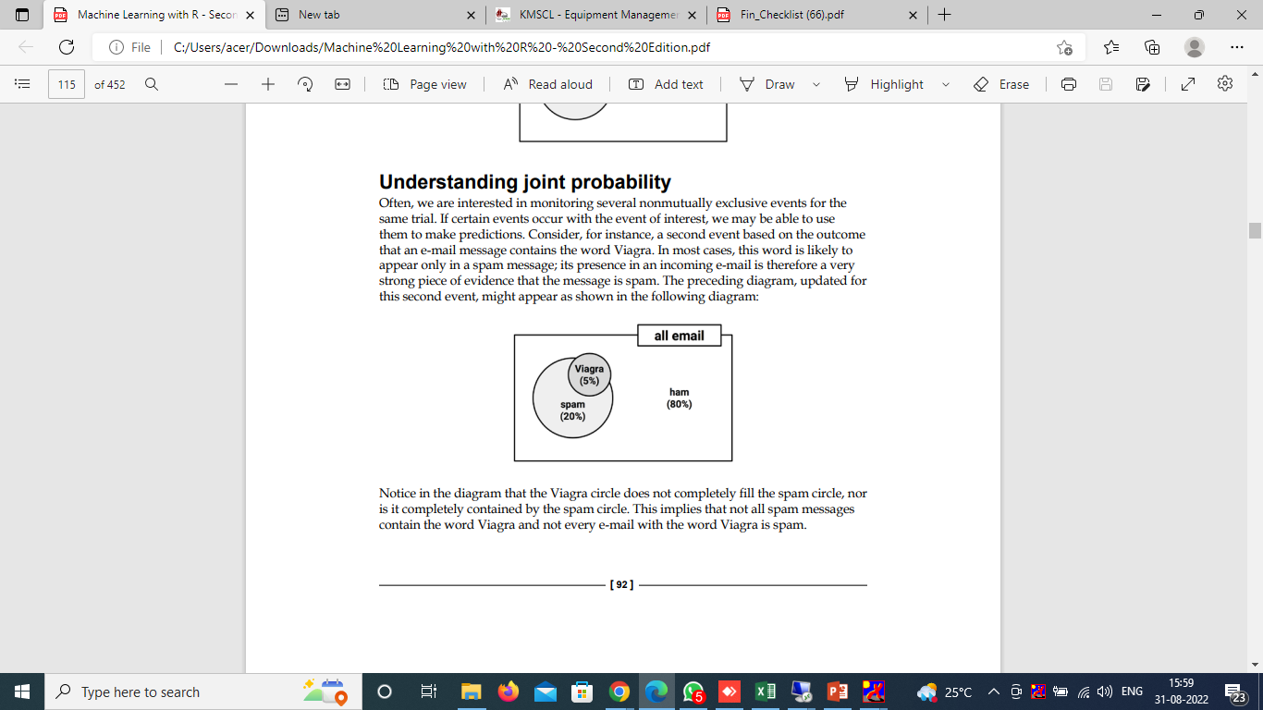
Understanding joint probability
If certain events occur with the event of interest, we may be able to use them to make predictions. Consider, for instance, a second event based on the outcome that an e-mail message contains the word Viagra. In most cases, this word is likely to appear only in a spam message; its presence in an incoming e-mail is therefore a very strong piece of evidence that the message is spam. The preceding diagram, updated for this second event, might appear as shown in the following diagram
In the diagram that the Viagra circle does not completely fill the spam circle, nor is it completely contained by the spam circle. This implies that not all spam messages contain the word Viagra and not every e-mail with the word Viagra is spam

Slide 7
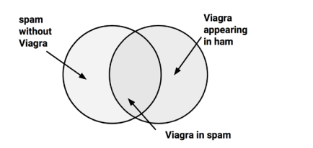
Venn diagram.
the diagram uses circles to illustrate the overlap between sets of items. In most Venn diagrams, the size of the circles and the degree of the overlap is not meaningful. Instead, it is used as a reminder to allocate probability to all possible combinations of events
We know that 20 percent of all messages were spam (the left circle) and 5 percent of all messages contained the word Viagra (the right circle). We would like to quantify the degree of overlap between these two proportions. In other words, we hope to estimate the probability that both P(spam) and P(Viagra) occur, which can be written as P(spam ∩ Viagra). The upside down 'U' symbol signifies the intersection of the two events; the notation A ∩ B refers to the event in which both A and B occur

Slide 8
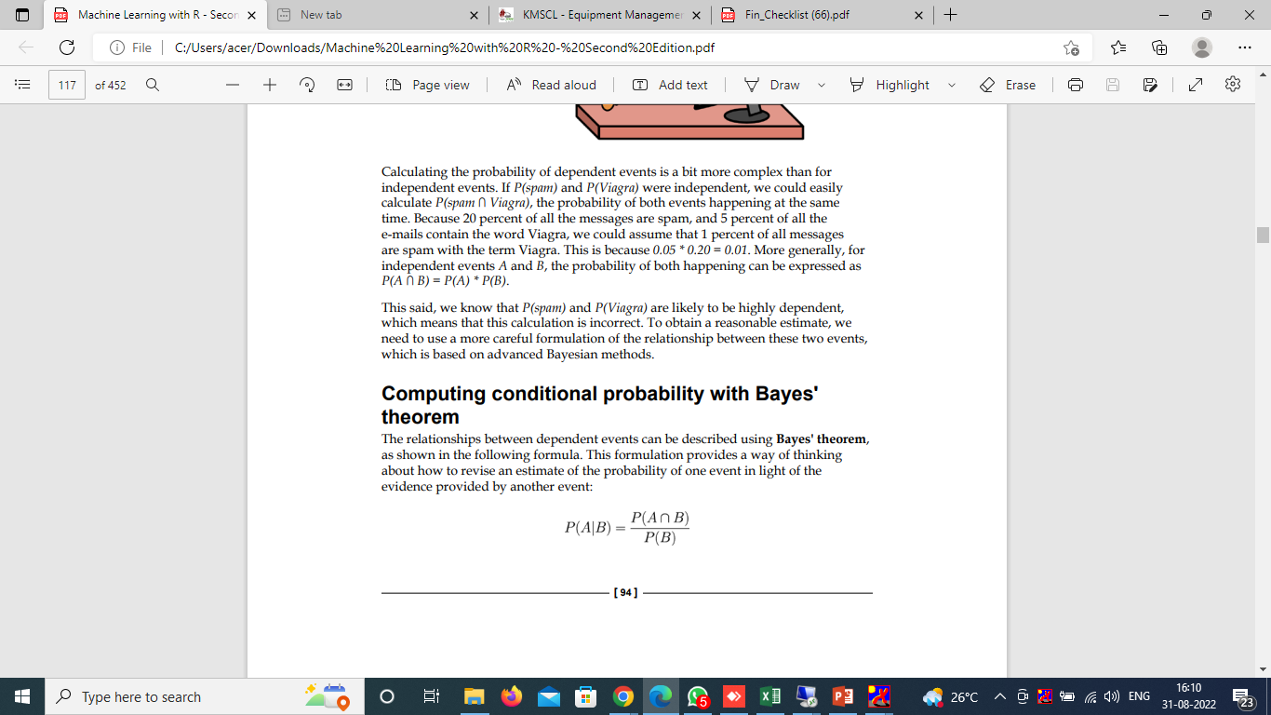
Calculating P(spam ∩ Viagra) depends on the joint probability of the two events or how the probability of one event is related to the probability of the other. If the two events are totally unrelated, they are called independent events
Computing conditional probability with Bayes' theorem
The relationships between dependent events can be described using Bayes' theorem, as shown in the following formula
The notation P(A|B) is read as the probability of event A, given that event B occurred. This is known as conditional probability,
By definition, P(A ∩ B) = P(A|B) * P(B), a fact that can be easily derived by applying a bit of algebra to the previous formula. Rearranging this formula once more with the knowledge that P(A ∩ B) = P(B ∩ A) results in the conclusion that P(A ∩ B) = P(B|A) * P(A), which we can then use in the following formulation of Bayes' theorem

Slide 9
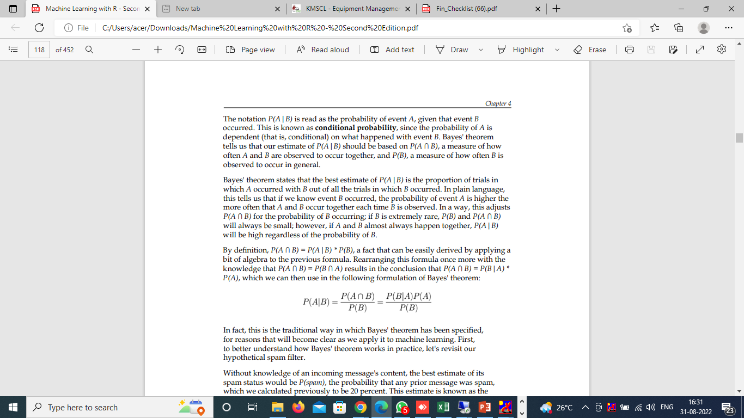
Rro
Without knowledge of an incoming message's content, the best estimate of its spam status would be P(spam), the probability that any prior message was spam, which we calculated previously to be 20 percent. This estimate is known as the prior probability.
The probability that the word Viagra was used in previous spam messages, or P(Viagra|spam), is called the likelihood. The probability that Viagra appeared in any message at all, or P(Viagra), is known as the marginal likelihood.
By applying Bayes' theorem to this evidence, we can compute a posterior probability that measures how likely the message is to be spam. If the posterior probability is greater than 50 percent, the message is more likely to be spam than ham and it should perhaps be filtered. The following formula shows how Bayes' theorem is applied to the evidence provided by the previous e-mail messages

Slide 10
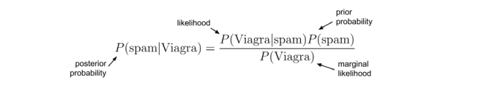
Dd
To calculate these components of Bayes' theorem, it helps to construct a frequency table (shown on the left in the following diagram) that records the number of times Viagra appeared in spam and ham messages. Just like a two-way cross-tabulation, one dimension of the table indicates levels of the class variable (spam or ham), while the other dimension indicates levels for features (Viagra: yes or no). The cells then indicate the number of instances having the particular combination of class value and feature value. The frequency table can then be used to construct a likelihood table, as shown on right in the following diagram. The rows of the likelihood table indicate the conditional probabilities for Viagra (yes/no), given that an e-mail was either spam or ham

Slide 12
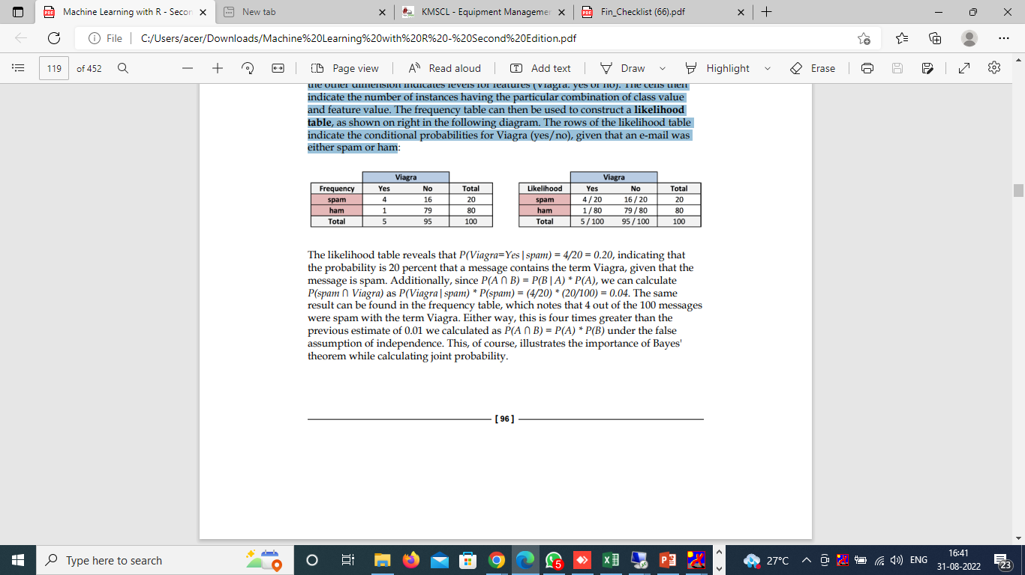
The likelihood table reveals that P(Viagra=Yes|spam) = 4/20 = 0.20, indicating that the probability is 20 percent that a message contains the term Viagra, given that the message is spam. Additionally, since P(A ∩ B) = P(B|A) * P(A), we can calculate P(spam ∩ Viagra) as P(Viagra|spam) * P(spam) = (4/20) * (20/100) = 0.04. The same result can be found in the frequency table, which notes that 4 out of the 100 messages were spam with the term Viagra. Either way, this is four times greater than the previous estimate of 0.01 we calculated as P(A ∩ B) = P(A) * P(B) under the false assumption of independence. This, of course, illustrates the importance of Bayes' theorem while calculating joint probabilit

Slide 13
To compute the posterior probability, P(spam|Viagra), we simply take P(Viagra|spam) * P(spam) / P(Viagra) or (4/20) * (20/100) / (5/100) = 0.80. Therefore, the probability is 80 percent that a message is spam, given that it contains the word Viagra. In light of this result, any message containing this term should probably be filtered

Slide 14
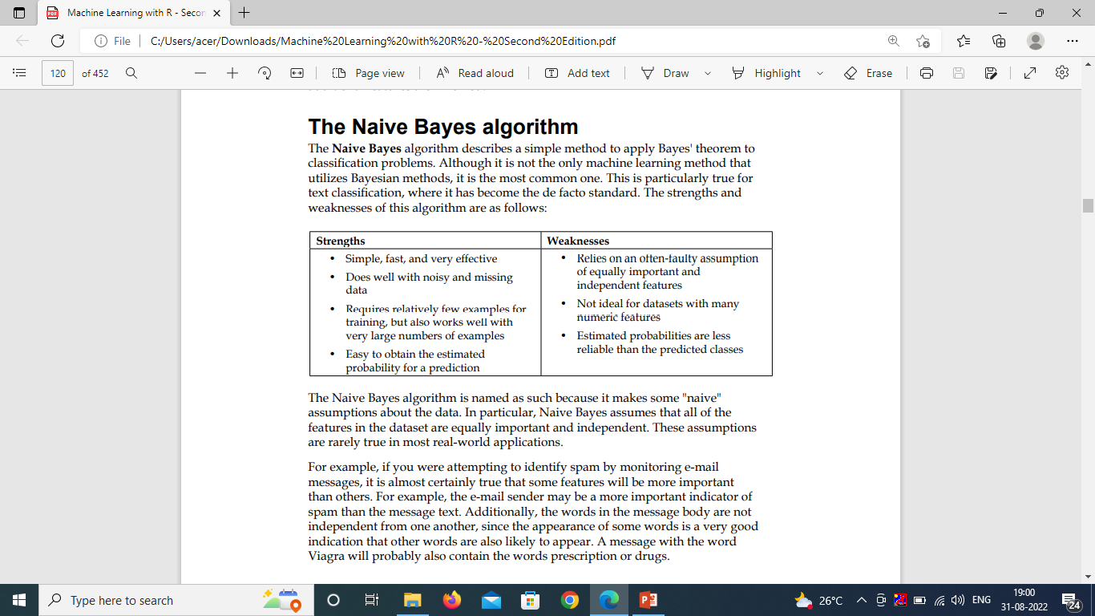
The Naive Bayes algorithm
The Naive Bayes algorithm describes a simple method to apply Bayes' theorem to classification problems. The strengths and weaknesses of this algorithm are as follows:
The Naive Bayes algorithm is named as such because it makes some "naive" assumptions about the data. In particular, Naive Bayes assumes that all of the features in the dataset are equally important and independent. These assumptions are rarely true in most real-world applications

Slide 15
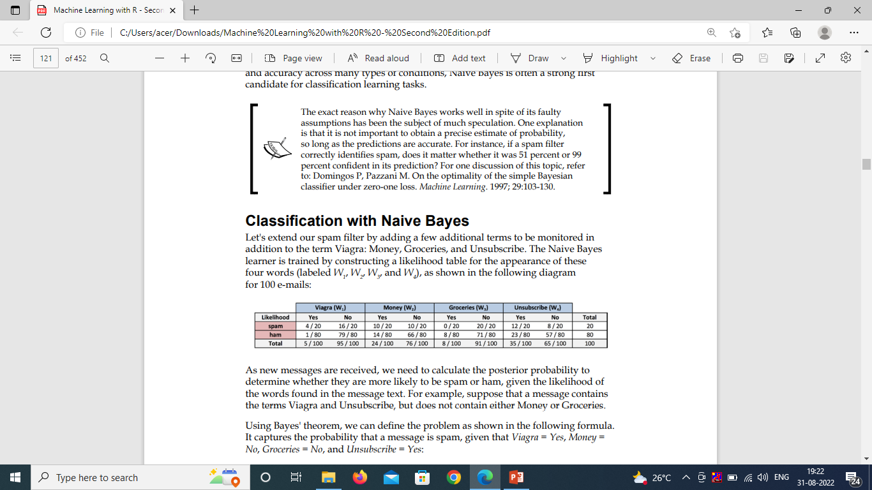
Classification with Naive Bayes
a few additional terms to be monitored in addition to the term Viagra: Money, Groceries, and Unsubscribe. The Naive Bayes learner is trained by constructing a likelihood table for the appearance of these four words (labeled W1 , W2 , W3 , and W4 ), as shown in the following diagram for 100 e-mails:
As new messages are received, we need to calculate the posterior probability to determine whether they are more likely to be spam or ham

Slide 16
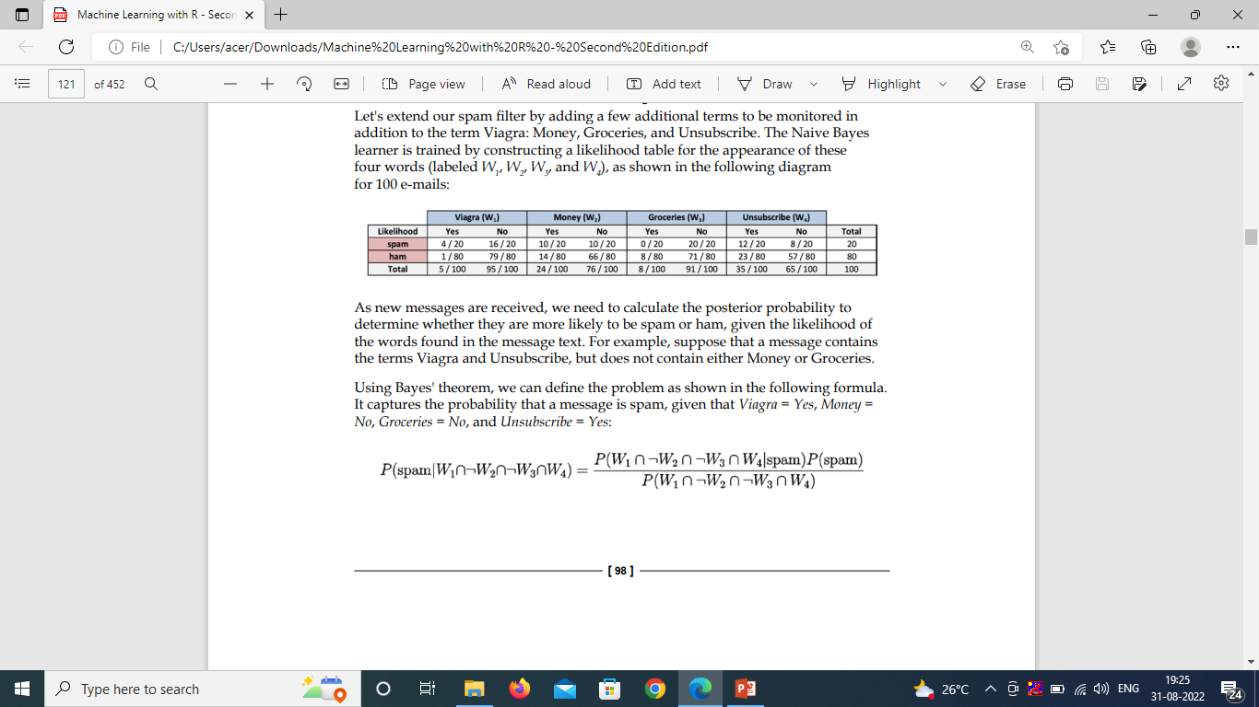
For example, suppose that a message contains the terms Viagra and Unsubscribe, but does not contain either Money or Groceries.
Using Bayes' theorem, we can define the problem as shown in the following formula.
It captures the probability that a message is spam, given that Viagra = Yes, Money = No, Groceries = No, and Unsubscribe = Yes:
Assuming conditional independence allows us to simplify the formula using the probability rule for independent events, which states that
P(A ∩ B) = P(A) * P(B). B

Slide 17
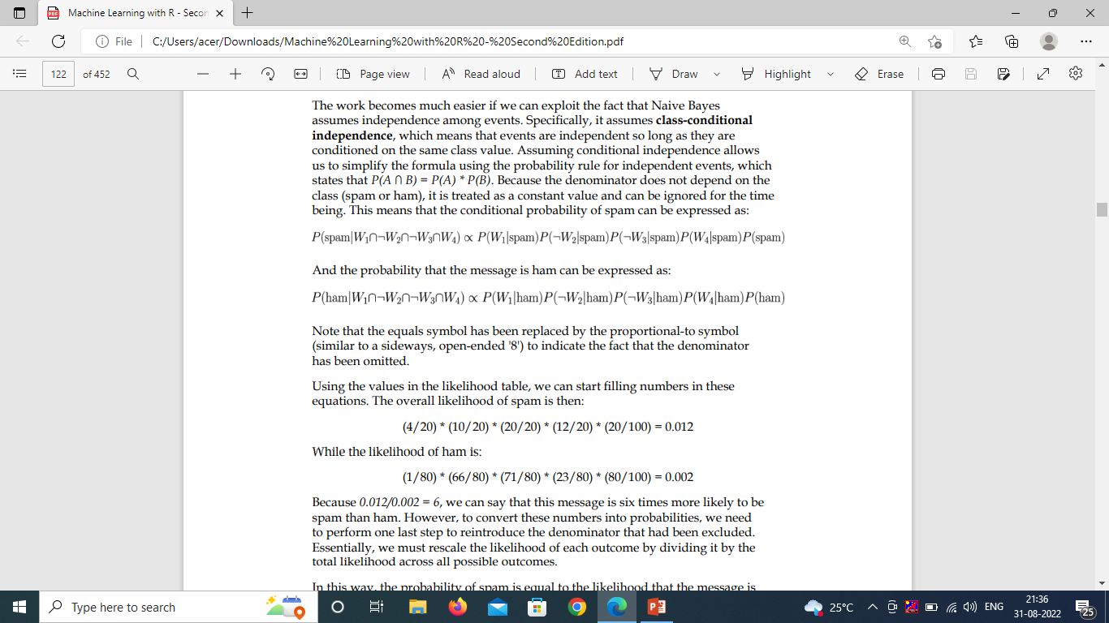

the conditional probability of spam can be expressed as:
the probability that the message is ham can be expressed as:
the equals symbol has been replaced by the proportional-to symbol to indicate the fact that the denominator has been omitted

Slide 18
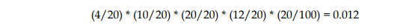
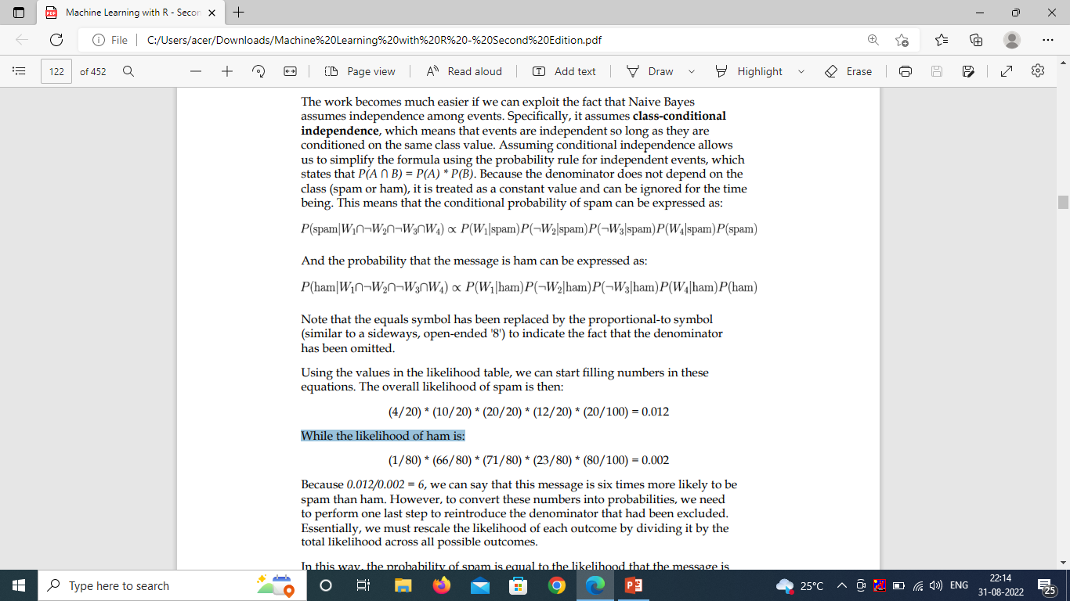
Using the values in the likelihood table,
The overall likelihood of spam is then:
While the likelihood of ham is:
=0.012/0.002 = 6,
….this message is six times more likely to be spam than ham.
to convert these numbers into probabilities,
0.012/(0.012+0.002)=0.857[the probability of spam is equal to the likelihood that the message is spam divided by the likelihood that the message is either spam or ham]

